Slide 8


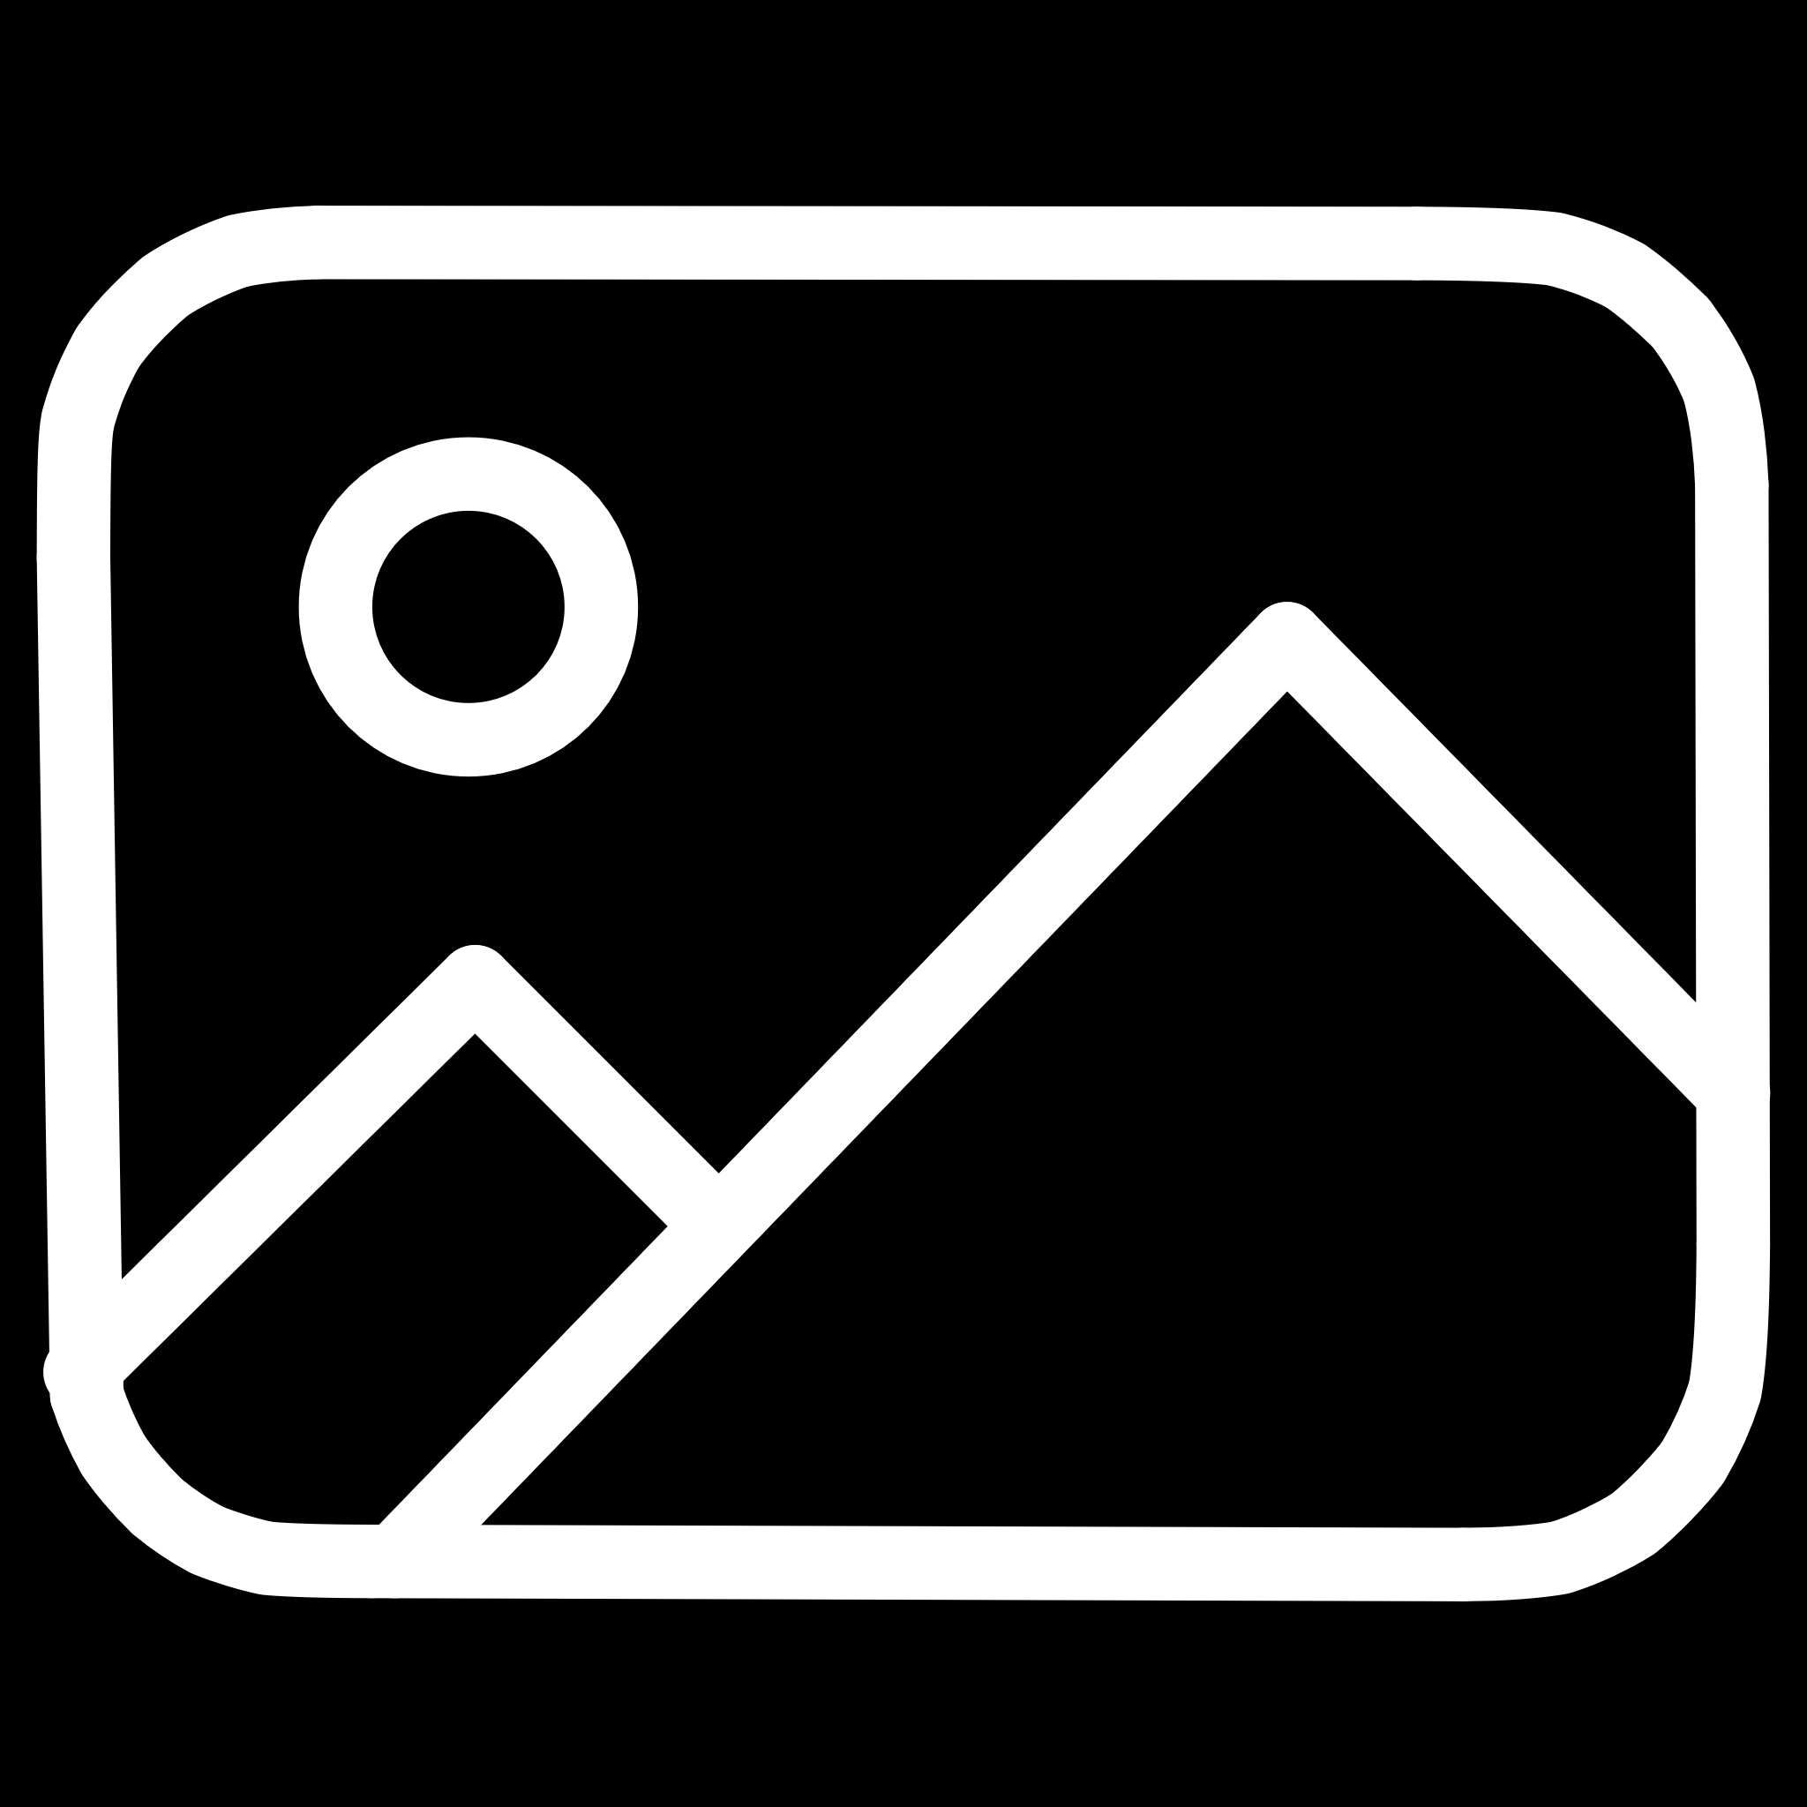
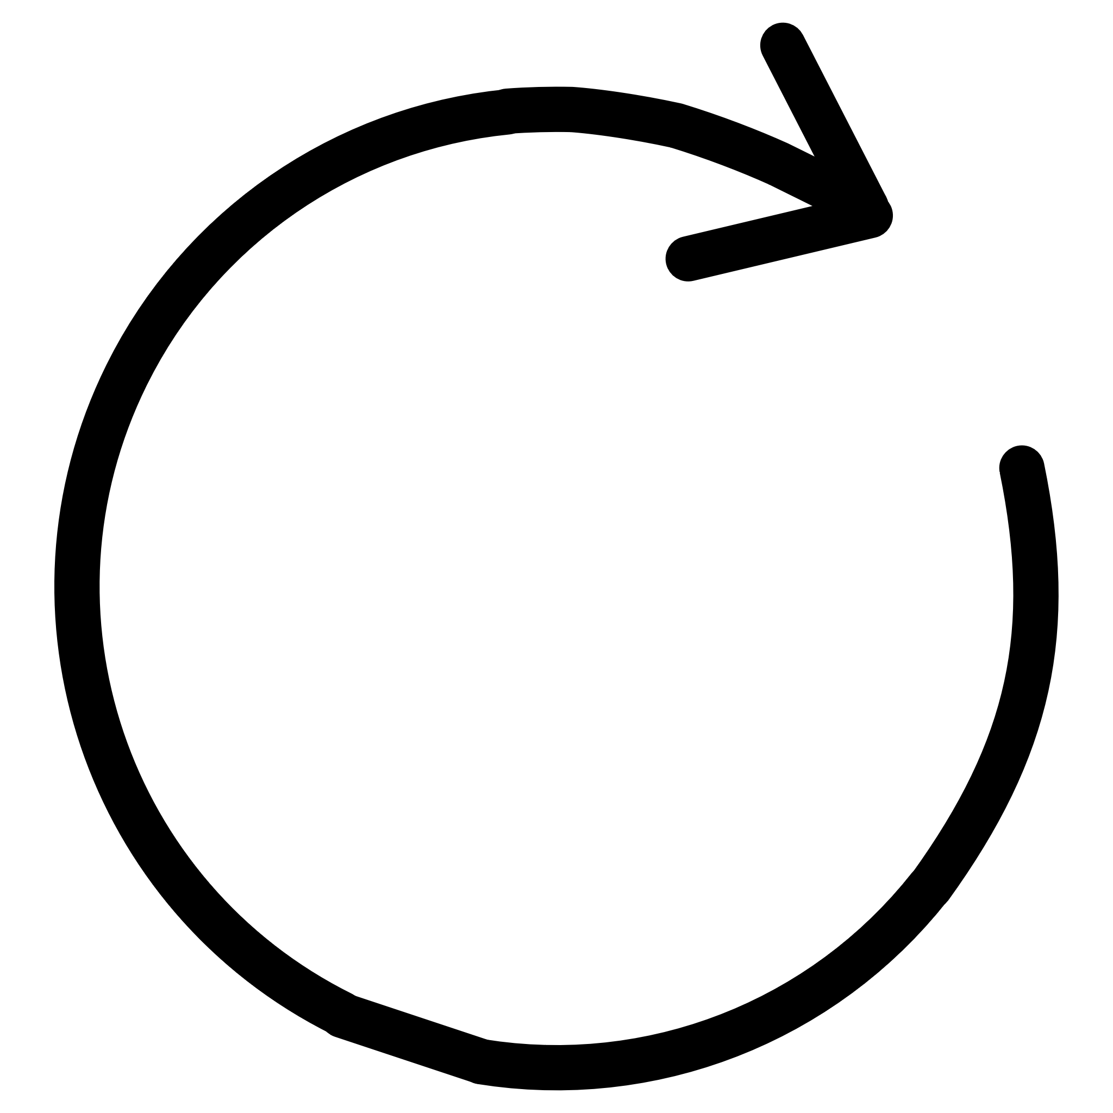
Best Model Performance
86.82%
0.4758
Test Accuracy
Final Loss
2 x Dropout 0.25, 3 x Dense, Global Average Pooling 2D
Input: 224x224
Augmentation: Random Flip, Rotation, Brightness, Contrast

